Slide 1
Rotation manipulation Advanced Game Design & Development
Danny Jugan

Slide 2

rotations
Angles come in two different types in Unity:
Quaternions
When you access transform.rotation of a game object, this is in the form of a quaternion
Quaternion (x, y, z, w)
Don’t mess with these unless you know when you’re doing.
Euler (pronounced Oiler) Angles
These are the angles that we’re familiar with
Euler (x, y, z)
The values you see in the inspector window are in the form of Euler angles.
When you’re manipulating rotations in Unity, you’ll want to mess with Eulers, not Quaternions.

Slide 3
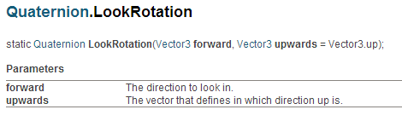
Lookrotation()
Great for getting the rotation towards a point
Static function mean you use the class name to call them instead of an object of the class.
transform.rotation = Quaternion.LookRotation(target);

Slide 4
Lookrotation()
Exercise:
Given the two Game Objects declared below, write the line(s) of code that would make the boy face the girl.
public GameObject boy, girl;
Vector3 towards = girl.transform.position – boy.transform.position;
boy.transform.rotation = Quaternion.LookRotation(towards);
A common exception:
“Look rotation viewing vector is zero”
if(towards != Vector3.zero)
boy.transform.rotation = Quaternion.LookRotation(towards);

Slide 5
Manually Setting rotations
There may be times in your game where you want to manually set the angle of an object.
Unless you know how to use Quaternions, it will be difficult to use:
transform.rotate = Quaternion;
Instead, you can use transform.eulerAngles.
transform.eulerAngles = new Vector3(x, y, z);

Slide 6
Rotating Vectors
You can rotate a Vector by multiplying it by a Quaternion.
Example:
//rotates the forward vector 45 degrees to the right
Vector3 right45 = Quaternion.Euler(0, 45, 0) * transform.forward;

Slide 7
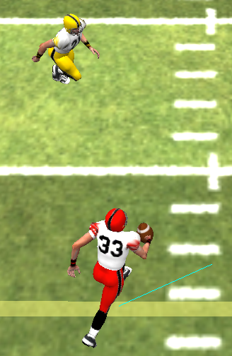
Rotating vectors exercise
Exercise:
Write the code to tell the ball holder (red player) to run 80 degrees to the right of the angle to the defender (yellow player).
public GameObject defender, ballHolder;
//target should end up at the red dot
Vector3 target;
80

Slide 8
Rotating vectors exercise
public GameObject defender, ballHolder;
Vector3 target;
//get vector to defender
Vector3 lookDir = defender.transform.position - ballHolder.transform.position;
//normalize because we care only about the direction
lookDir = lookDir.normalized;
//rotate vector 80 degrees to the right
target = Quaternion.Euler(0, 80, 0) * lookDir;
//if you need to project the point out farther, multiply it by a value

